Slide 1
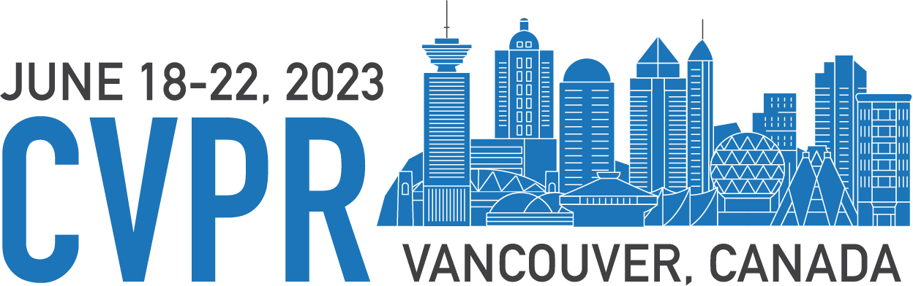

Boundary Unlearning: Rapid Forgetting of Deep Networks
via Shifting the Decision Boundary
Min Chen, Weizhuo Gao, Gaoyang Liu, Kai Peng, Chen Wang*,
﻿Hubei Key Laboratory of Smart Internet Technology, School of EIC,
Huazhong University of Science and Technology
Code is available on https://www.dropbox.com/s/bwu543qsdy4s32i/Boundary-Unlearning-Code.zip?dl=0
Notes:
Hi, I’m Chen Min from HUST and I’m glad to share our CVPR work Boundary Unlearning.
Machine unlearning is gaining increasing attention due to the practical needs of the “right to be forgotten” and poisoned data removal. Machine unlearning enable machine learning models to unlearn, or to forget a fraction of training data and its lineage.
In this paper, we ﻿propose Boundary Unlearning, a rapid yet effective way to unlearn the forgetting class from a trained DNN model. Boundary Unlearning tries to shift the decision boundary of the original DNN model to imitate the decision behavior of the retrained model.
﻿Boundary unlearning achieve effective machine unlearning from the perspective of shifting the decision boundary, which is different from previous parameter-oriented approaches that are computationally expensive due to the large dimension of the parameter space.

Slide 2
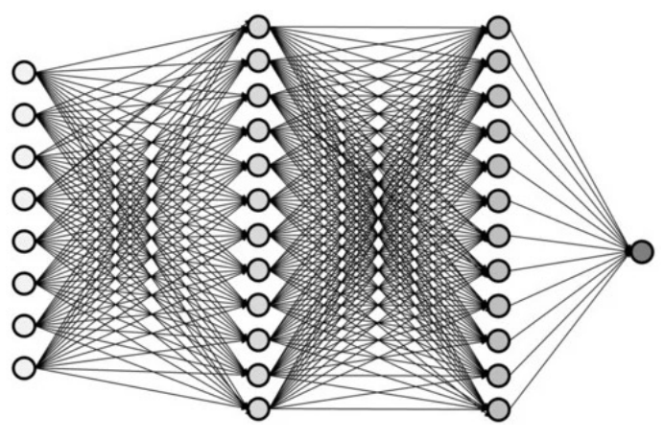


Background
DNNs have become ubiquitous tool in developing data-driven services.
Power lies in the large
parameter space
DNNs cause unintended
memorization
DNNs may memorize
sensitive or flawed data
DNNs with poor interpretability
Notes:
Now, let’s dive into details of Boundary Unlearning.
First, we will show you WHY we need machine unlearning?
Recently, DNNs have become ubiquitous tool in developing data-driven services. However, DNNs are Powerful yet mysterious.
The power of DNNs lies in the large parameter space, which make it difficult for us to understand DNN.
Specifically, we can’t understand of what knowledge the model has learned from data and where the model stored the knowledge.
Thus, DNNs may cause some unintended memorization, which contain some sensitive or flawed data and will bring security risks for DNN services.

Slide 3


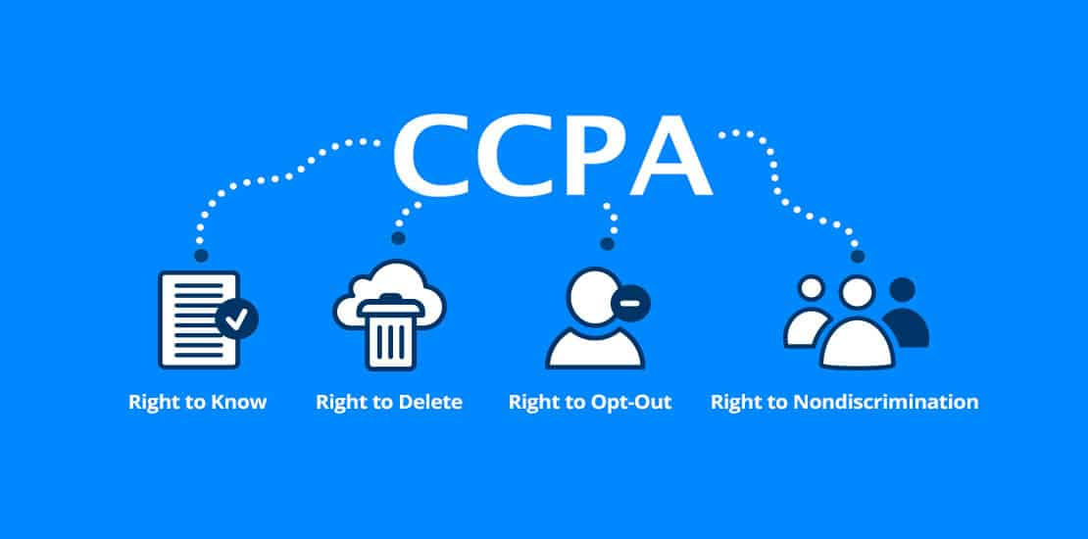
IMG_0835.PNG
Background
Data
learning
model
Forget request
Users
Sensitive data
unlearning
Retrained
model
Unlearned
model
Notes:
For examples, a well-trained DNN may remember sensitive data, like,﻿ credit card numbers or facial information, of users, which may cause the leakage of privacy information. Thus, a lot of privacy ﻿regulations have been conducted, such as GDPR & CCPA.
Both of these regulations ﻿give individuals “the right to be forgotten” and ﻿mandate that companies have to erase personal data once it is requested.
On the other hand, DNN may be planted with some poisoned data or backdoors, which may bring some security risks.
To solve these problems, ﻿a naive yet optimal way is retraining model from scratch with the remaining data, but it is expensive in terms of the cost of training time and resources.
﻿These practical needs call for efficient machine unlearning techniques, which enable ML models to unlearn, or to forget a fraction of training data and its lineage.

Slide 4
Early studies
Retrain Acceleration for DNN Models：
SISA
Amnesiac unlearning
Deltagrad
…
have to intervene the original training pipeline
and hurt the utility of the DNN model
Updating Parameters for DNN Models：
Fisher forgetting
NTK forgetting
SSSE
…
cost too much computational resource
Problem: How to reduce the computational complexity?
Notes:
Machine unlearning is first introduced on convex models to find some comprehensible indications, but is found more useful and challenging for DNNs. Existing unlearning methods for DNNs can be broadly categorized into two groups: retrain acceleration and updating parameters.
Retrain acceleration approaches have to intervene the original training pipeline and hurt the utility of the DNN model. And, previous updating parameters approaches cost too much computational resource, because they need to locate and scrub the most influential parameters in terms of forgetting data.
We follow the updating parameters approaches, cause this branch of methods is more practical for machine learning service online.
But the problem is: How to reduce the computational complexity of updating parameters-based unlearning approaches?
The computational complexity of these methods is mainly stem from the large dimension of the parameter space.

Slide 5
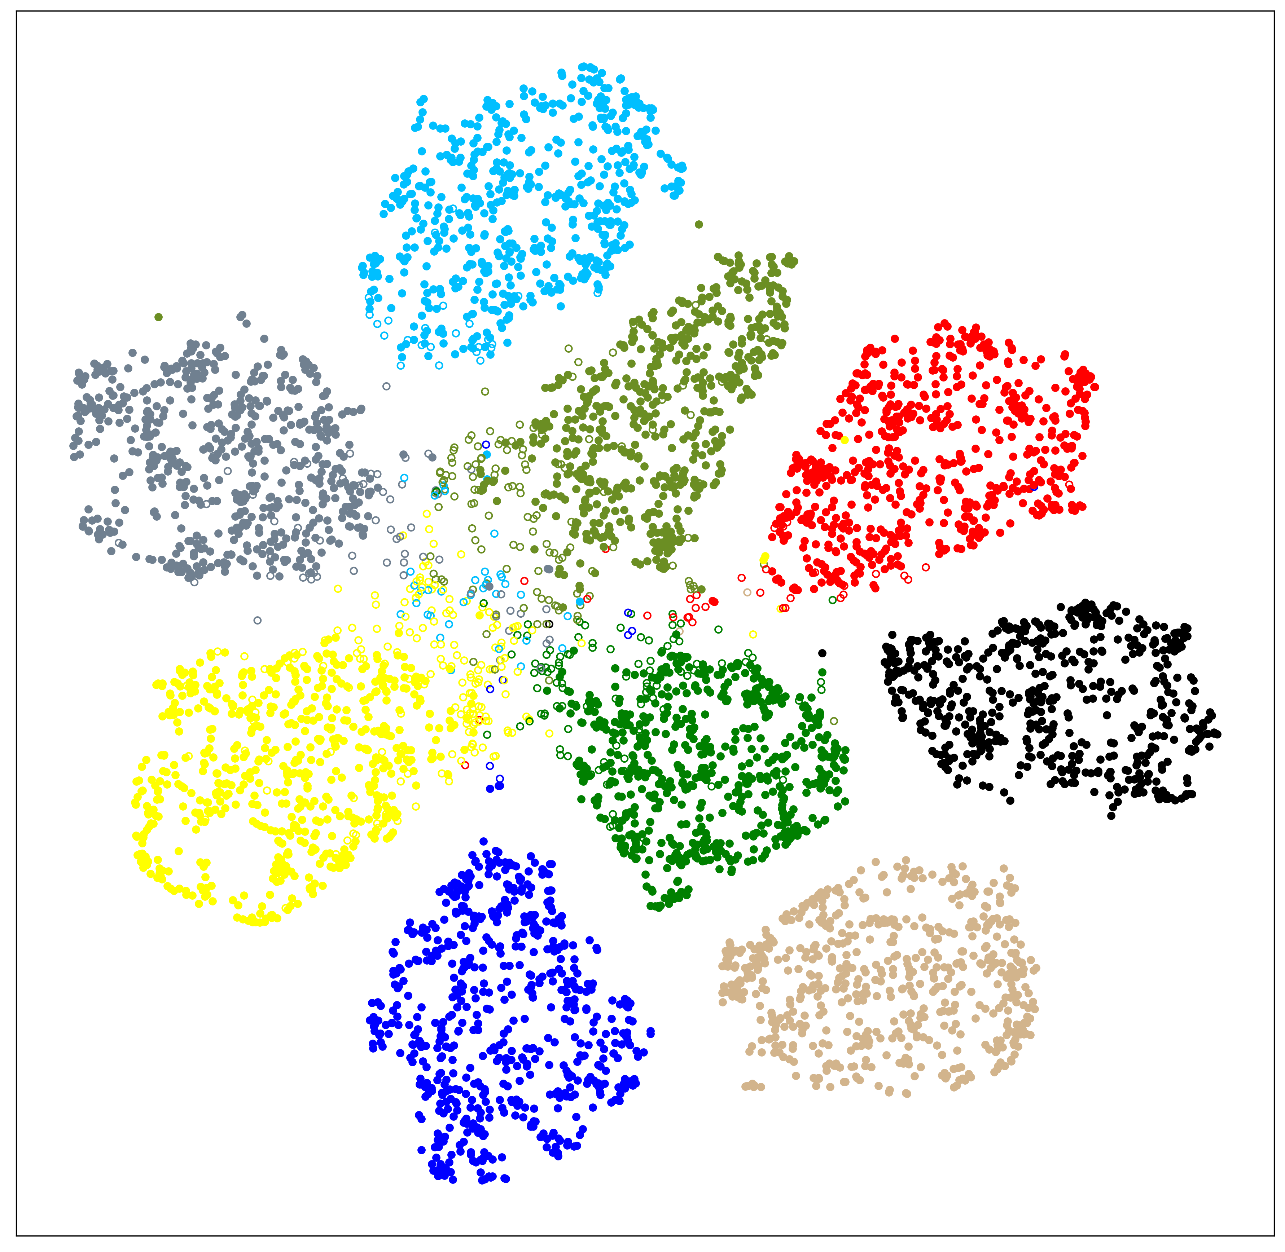
Observations
the forgetting samples spread around the decision space of
the retrained DNN model
﻿the utility guarantee can be achieved by only destroying the boundary of the forgetting class but maintaining the boundary of the remain classes
most of the forgetting samples move to the border of other clusters.
﻿the privacy guarantee can be accomplished by pushing the forgetting data to the border of other clusters
Decision Space of the Retrained DNN
Notes:
In order to find an efficient unlearning approach to forget an entire class, we visualize the decision space of the retrained DNN model and discover two key observations:
﻿First, the forgetting samples spread around the decision space of the retrained DNN model, indicating that the decision boundary of the forgetting samples has been broken.
Second, most of the forgetting samples move to the border of other clusters.
﻿These two observations naturally match the two critical goals of machine unlearning: utility and privacy guarantees.
﻿Based on our key observations, the utility guarantee can be achieved by only destroying the boundary of the forgetting class but maintaining the boundary of the remain classes, while the privacy guarantee can be accomplished by pushing the forgetting data to the border of other clusters.

Slide 6
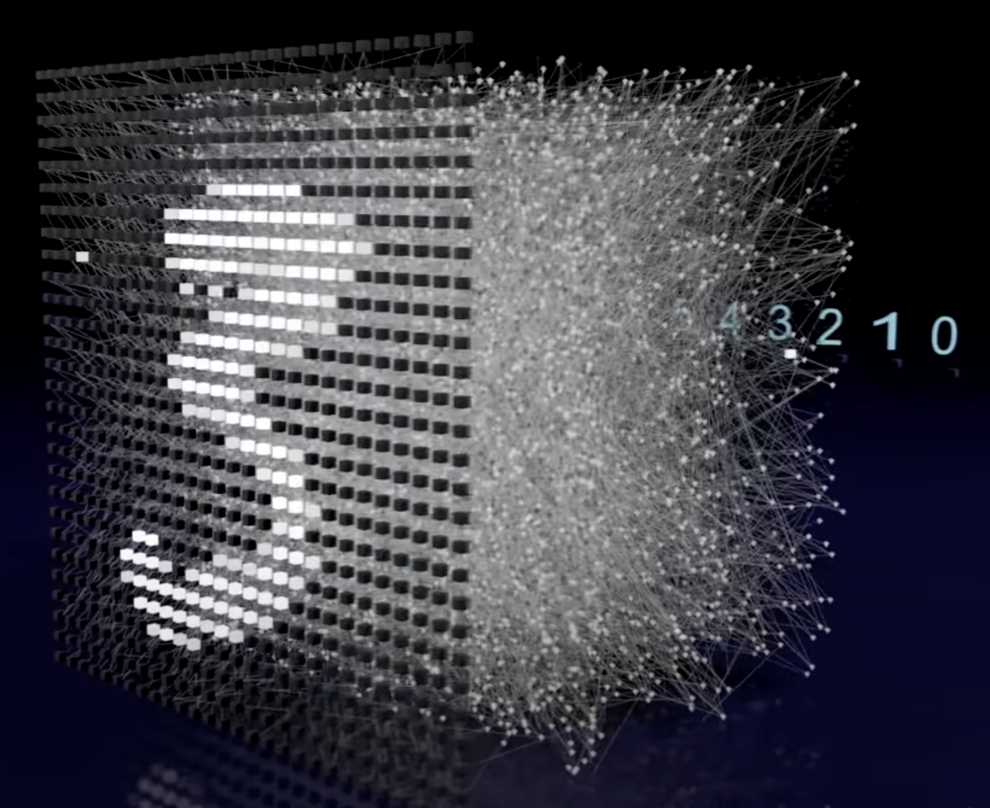
Motivation
Parameter space
Decision space
Notes:
Hence, we can’t help wandering that do we really need to exploring the whole parameters space directly to forget specific information of DNN?
As we all know, decision boundary is an important manifestation of DNN. Besides, decision boundary is dominated by the parameters.
In the light of this idea, ﻿we transfer our attention from parameter space to decision boundary.
we try ﻿to accomplish machine unlearning by shifting the decision boundary of the original DNN model and imitating the decision behavior of the retrained model the decision boundary, which is a new perspective and different from previous parameter-oriented approaches.

Slide 7
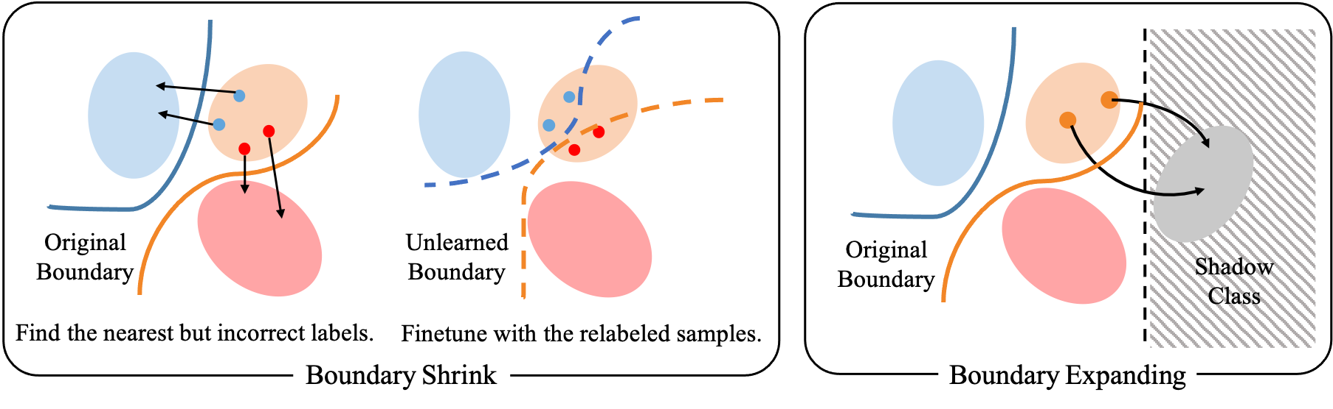
Our approach
High level overview of Boundary Unlearning
Notes:
Observing that imitating the decision behavior of the retrained model is able to accomplish the utility and privacy guarantees of machine unlearning, we ﻿design two strategies to shift decision boundary in Boundary Unlearning: ﻿Boundary Shrink and Boundary Expanding.
Boundary Shrink breaks the decision boundary of the forgetting class by splitting the forgetting feature space into other classes,
while Boundary Expanding disperses the activation about the forgetting class by remapping and pruning an extra shadow class assigned to the forgetting data.

Slide 8


Our approach
how to shift the boundary & which direction to shift? ⇒ Boundary Shrink
Finetune with randomly labeled data.
﻿Shrink the decision space of forgetting sample
Notes:
An intuitive way to break the decision boundary of forgetting class is finetuning the original model with randomly labeled forgetting data.
However, randomly labeling will also shift the boundary of the remaining class randomly, leading to the ﻿degeneration of utility the on remaining data.
Thus, finetuning with specifically labeled forgetting data is an efficient way to shift the decision boundary of forgetting data, but we need to find right direction to shift.
﻿As can be observed from the decision space of the retrained DNN model, most of the forgetting samples are predicted as specific classes, instead of random classes. It reminds us to discover the similarity between forgetting samples and samples of other classes in the feature space.
﻿we thus propose a neighbor searching method to identify the nearest but incorrect class labels to guide the way of boundary shifting.
﻿The nearest but incorrect labels help to shrink the boundary of forgetting sample from the sides of other classes, which split the decision space of the forgetting class and shift the boundary of remaining class as little as possible.

Slide 9
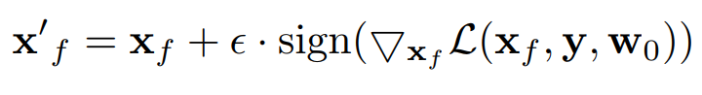
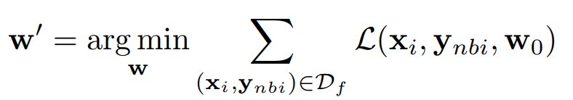
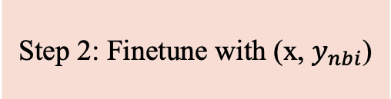
Our approach
how to shift the boundary & which direction to shift? ⇒ Boundary Shrink
Step 1: ﻿Neighbor searching
Step 2: ﻿Finetune with (x, $y_{nbi}$)
Notes:
Specifically, we first push the forgetting data across the nearest boundary and we take the predicting lables of cross samples as the nearest but incorrect labels.
Then, we finetuning the original model with the pairs of original forgetting data and the nearest but incorrect labels.

Slide 10
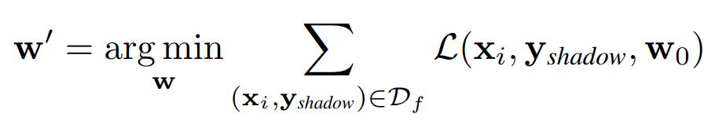
Our approach
how to shift the boundary & which direction to shift? ⇒ Boundary Expanding
speed-up version
New area
Notes:
Although Boundary Shrink achieves both utility and privacy guarantee well, it may cost some time during the neighbor searching. So, we propose Boundary Expanding which aims to imitate the decision behavior of the retrained model even more quickly.
﻿In Boundary Expanding, ﻿we artificially assign forgetting samples to an extra shadow class of the original model, which will exploit a new area on decision space.
﻿Recall that we start from our observation that most of forgetting samples move to the border of other clusters on the retrained model.
﻿This phenomenon means the forgetting data are predicted as other classes with low certainty. As for a single sample, low certainty represents the output vector is more even.
Based on this phenomenon, we design a boundary expanding and remapping method to disperse the activation about forgetting data of the unlearned model.
﻿More specifically, we first introduce an extra shadow class to expand the decision space. ﻿Then, we finetune the expanded model with the forgetting samples reassigned with the shadow class label.

Slide 11
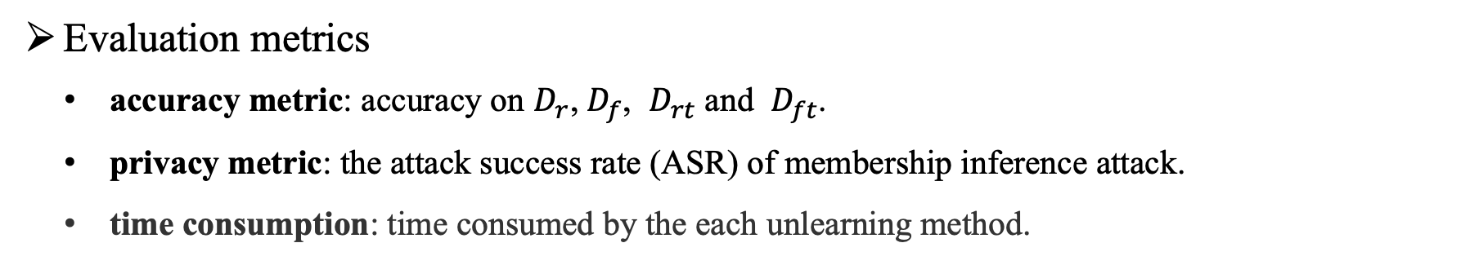
Evaluation Results
Dataset and Model Architecture
Dataset
Model
Task
CIFAR-10
All-CNN
Image classification
Vggface2
ResNet50
Face recognition
Evaluation metrics
accuracy metric: accuracy on $D_{r}$, $D_{f}$, $D_{rt}$ and $D_{ft}$.
privacy metric: the attack success rate (ASR) of membership inference attack.
time consumption: time consumed by the each unlearning method.
Notes:
From now on, we will share some evaluation results.
﻿We conduct experiments on CIFAR-10 and Vggface2 datasets﻿ to test unlearning performance on image classification task and face recognition task.
﻿We verify the unlearning performance on both utility and privacy guarantees. ﻿The unlearned model is expected to get close accuracy and privacy metrics with the retrained model. The time consumptions of unlearning methods are expected to be small.

Slide 12
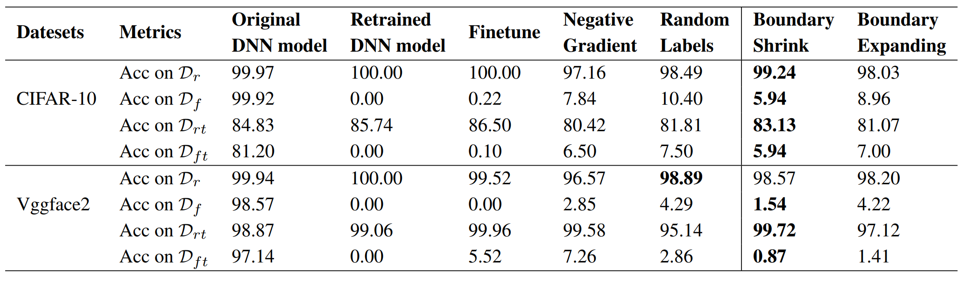
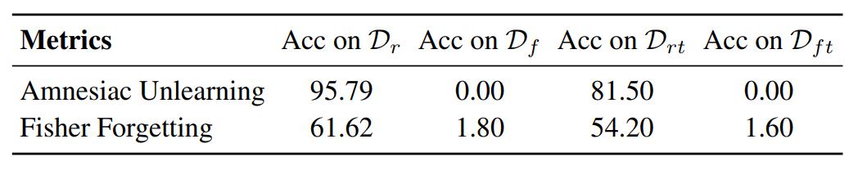
Evaluation Results
Utility Guarantee
Notes:
We first verify the utility guarantee of Boundary Unleaning. Recall that Utility guarantee ensures that the unlearned model should generalize badly on the forgetting data while the prediction performance on the remaining data is maintained.
﻿From the results we can observe that all the baselines can erase the information of Df to some degree but these methods may cost more time or insufficient unlearning.
﻿Boundary Shrink harms the information of Dr to the least extent and erases Df most completely.
﻿Similarly, Boundary Expanding also maintains the accuracy on Dr and Drt. However, it leaves more residual information about Df than Boundary Shrink. ﻿As mentioned before, we take Boundary Expanding as a faster alternative method, which takes a tradeoff between performance and time consumption.
The second table show that Fisher Forgetting erases Df optimally (only preserves 1.8% accuracy on Df) but fails to maintain the utility on Dr.
﻿Amnesiac Unlearning erases information about Df ideally, but still hurts the utility of Dr as it intervenes the original training process.

Slide 13
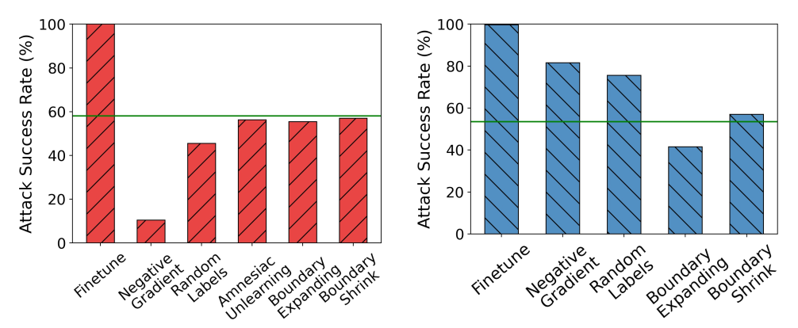
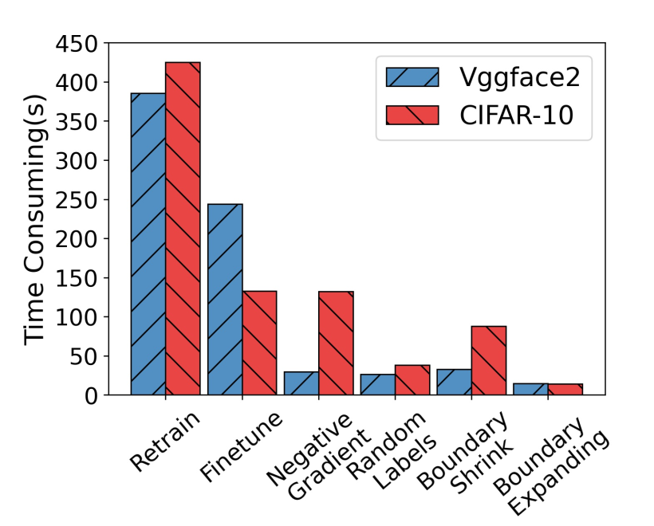
Evaluation Results
Privacy Guarantee and Time ﻿Consumption
﻿On CIFAR-10
﻿On Vggface2
﻿On CIFAR-10
﻿Boundary Unlearning methods can achieve a better performance on privacy guarantee effectively and quickly.
Notes:
Next, we turn to evaluate the privacy guarantee to ensure that the unlearned model by our Boundary Unlearning does ﻿not leak any information about the forgetting data.
﻿For privacy guarantee, we construct a simple yet general membership inference attack (MIA) based on [32] using the output of the unlearned model and test the attack success rate (ASR). ﻿Ideally, a forgetting procedure should have the same attack success as a retrained model, which is represented with the green lines.
As shown in the figures, boundary unlearning can achieve quite close ASR to that of the retrained model on both datasets.
﻿we also report the time consumed by each unlearning method to show the computational complexity.
﻿On the Vggface2 dataset, Boundary Expanding and Boundary Shrink reduce the forgetting time by 26.6× and 11.7×, respectively. As for CIFAR-10 dataset, Boundary Expanding and Boundary Shrink provide a speed-up of 29.7× and 4.8×, respectively.

Slide 14
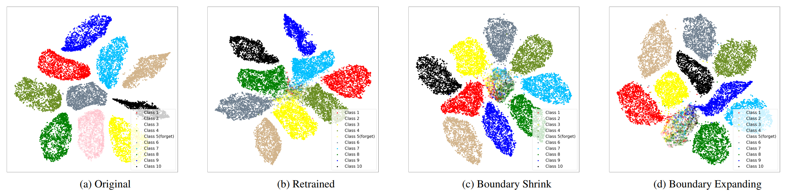
Evaluation Results
﻿Visualization of Decision Space
﻿Boundary Unlearning imitated boundary of retrained model and thus accomplishes the unlearning efficacy.
Notes:
We can find that the forgetting data (hollow circles) has been predicted as the nearest classes after applying Boundary Shrink and ﻿some hollow circles move to other clusters. Meanwhile, ﻿the clusters of remaining classes still keep compact, which means the model utility to the remaining data is maintained.

Slide 15
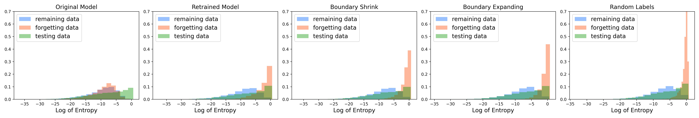
Evaluation Results
﻿Distribution of the Entropy of Model Output
﻿the unlearned model predicts them with low confidence like predicting the testing samples.
Notes:
We observe that scrubbing Df from the original model by Boundary Unlearning makes the distribution of model’s output on Df more uniform, which means the model is less confident about the prediction. We believe that the change about the distribution is caused by the shifting of the decision boundary.

Slide 16
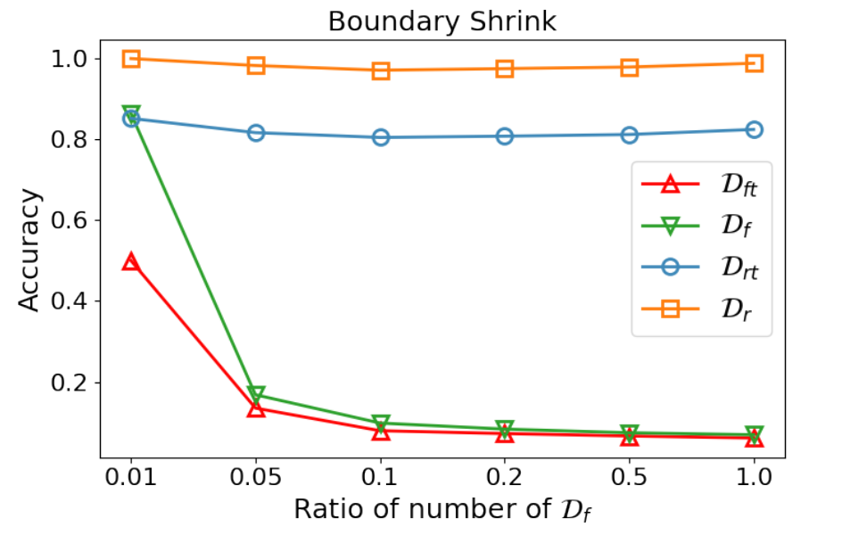
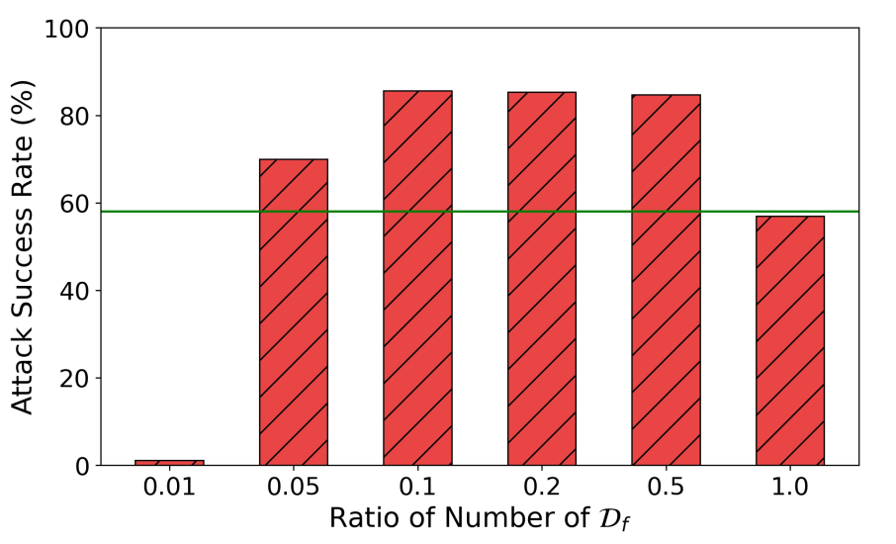
Evaluation Results
﻿Impact of Number of Samples Needed
Boundary Shrink can still forget the entire class with less forgetting samples
Notes:
we can find that Boundary Shrink can still forget the entire class with less forgetting samples. But the accuracy degenerates when the ratio gets very ﻿small, e.g., ratio is 0.05 (only 250 forgetting samples). More importantly, the level of privacy protection will decline as the ratio gets smaller, indicating that the information about Df can inferred more easily. Similar trend can also be observed for Boundary Expanding.

Slide 17
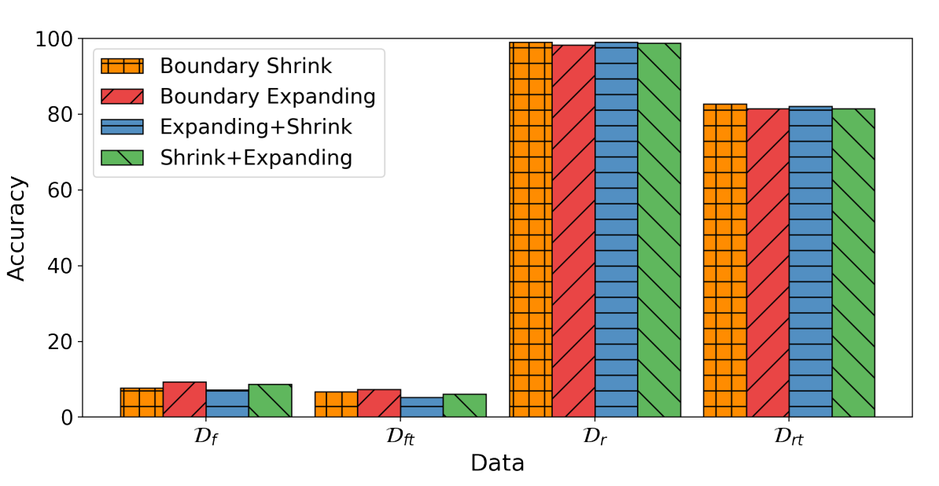
Evaluation Results
﻿Combination of Boundary Shrink and Boundary Expanding
“﻿first running Boundary Expanding and then Boundary Shrink” may be the best combination
Notes:
﻿From the result of boundary unlearning methods and their combination, we can tell that it may be the best combination that first dispersing the activation about Df by Boundary Expanding and then clear away the residual information about Df by Boundary Shrink.

Slide 18
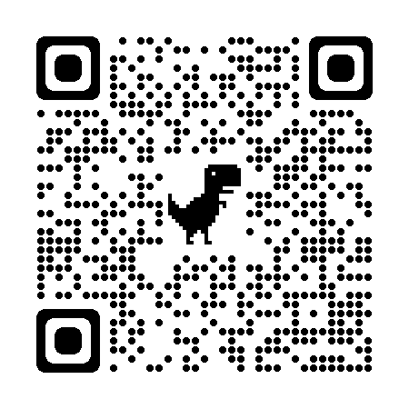
Conclusion
Boundary Unlearning: the first machine unlearning methodology to remove information of an entire class
from a trained DNN by shifting the decision boundary
We envision our work as a practical step in machine unlearning towards revealing the relationship
between decision boundary and forgetting
More interesting results in the paper
Attention map before and after unlearning
Discussion on utility and privacy guarantee of unlearning
Boundary Shrink with different hyperparameters

